Slide 1

AMZN STOCK ANALYSIS: ETL PIPELINE
Presented by the Pipeline Pandas
Amrita | Nick | Jasmine | Alejandro

Slide 2
Table of Contents
01
02
03
04
05
06
Overview
Checkpoint 1: Extraction
Checkpoint 2: Transformation
Checkpoint 3: Loading
Checkpoint 4: Analysis
Lessons Learned

Slide 3
01
Overview

Slide 4

Overview of Project
By using semi-structured data, specifically about daily changes in Amazon stock prices, we will create a data pipeline locally, utilizing extraction, transforming, loading and analysis to achieve clean, structured data as well as insightful analysis.
The deliverable of this product will be a SQL database with transformed and cleaned data as well as statistical insights.
Notes:
So, for the overview, we used a dataset about Amazon stock prices from 1999 to the present day. This allowed us to create a data pipeline by using extraction, transformation, loading and analysis. By doing so, in the end we were able to upload this data to a SQL database as well as showcasing meaningful statistical insights.

Slide 5
02
Checkpoint 1: Extraction

Slide 6
Extraction
For extraction, we choose to go with a dataset from https://www.alphavantage.co/ using their stock market API.
Using the requests module in Python, we first retrieved the dataset from the URL, with some parameters.
This would efficiently return a JSON file of the dataset.
Later in the code, we can then make a call to api_call to retrieve the JSON and store it in a variable.
Notes:
To retrieve this data for extraction, we can utilize the stock market API from alphavantage. We can then create a function which could make an API call with a specified output size, and which would return a JSON representation of the data. Having this, we can now make a call to the API.

Slide 7
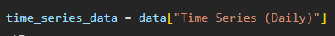
From this data, we can then further specify that we want the actual data from within the JSON.
After this, we can then use this to finally convert into a dataframe.
Notes:
The JSON was quite nested, so we have to specifically reference the raw data, stored in time_series_data. Now, we can finally make the conversion to a dataframe. The .T property was applied to transpose because the initial data was oriented incorrectly, however this fixed it.

Slide 8
03
Checkpoint 2: Transformation

Slide 9
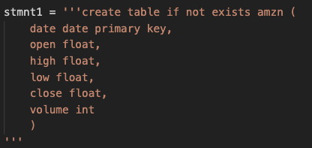
Upon converting the data into json we converted all the values into floats.
This will detect and transform any values which are received as strings, ensuring minimal data loss while maintaining data quality and consistency.
Although we found our data source to be very clean, we decided to quickly convert any leftover ‘string’ values in the dataset. This would not delete any irregular data but convert it and turn all of it into a more desired data type

Slide 10
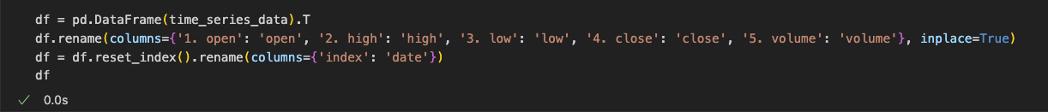
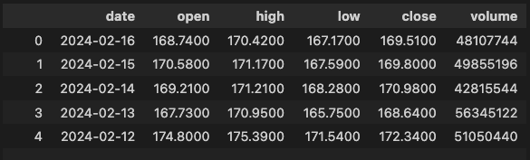
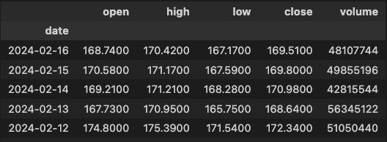
Followed by the transformation code which set the new columns for our Dataframe
Finally changing the dataframe from the index as primary key
—> to the date, as each date is already unique.
Keeping our dataframe to essential information only.

Slide 11
Adding a final column
Using the pandas .rolling() function we added a useful piece of data.
Collects an average value of the closing average
The rolling mean at each point is the average of the current value and the two preceding values within the window.
Valuable information for traders

Slide 12
04
Checkpoint 3: Loading

Slide 13
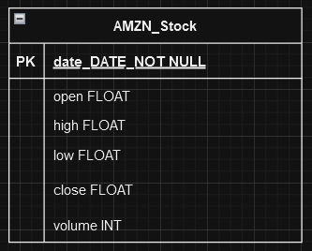
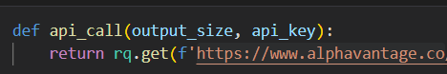
Data Loading
Schema
Selective Insertion
Given the nature of the retrieved data, a simple schema was judged to be sufficient. Primary key would be the date, as that was guaranteed to be a unique value.
Most of this checkpoint's complexity lay in the mechanics of only inserting non-duplicate data into the SQLite table every time the code was run to avoid the 'unique key' error.
Depending on the state of the table ie. empty/not empty, the parameters of the API call would change.
The output size is either 'full' (entire dataset) or 'compact' (last 100 days' worth):

Slide 14
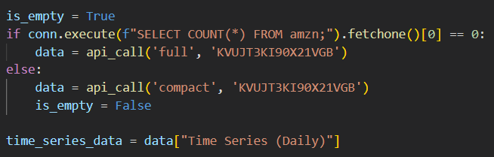
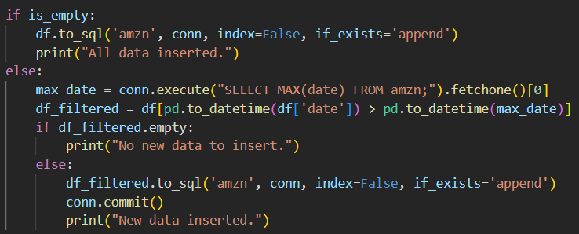
If database table is empty, full dataset for AMZN stock is retrieved via api_call() function
If there is already data in the table, only last 100 rows of data will be retrieved
Either way, retrieved data is then converted to a dataframe.
If table empty, entire dataframe will be inserted via SQLite
If there is already data in table, only the most recent, non-duplicate entries will be inserted
By comparing every entry date to the latest date already present in the table, redundant data and unique key error are no longer issues

Slide 15
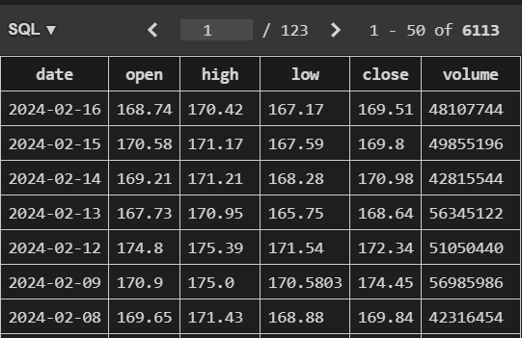
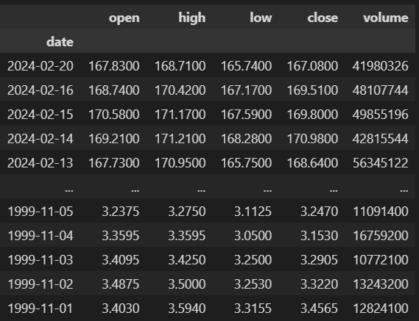

Success!
Initial insertion
Data update

Slide 16
05
Checkpoint 4: Analysis
Notes:
Amrita’s part

Slide 17
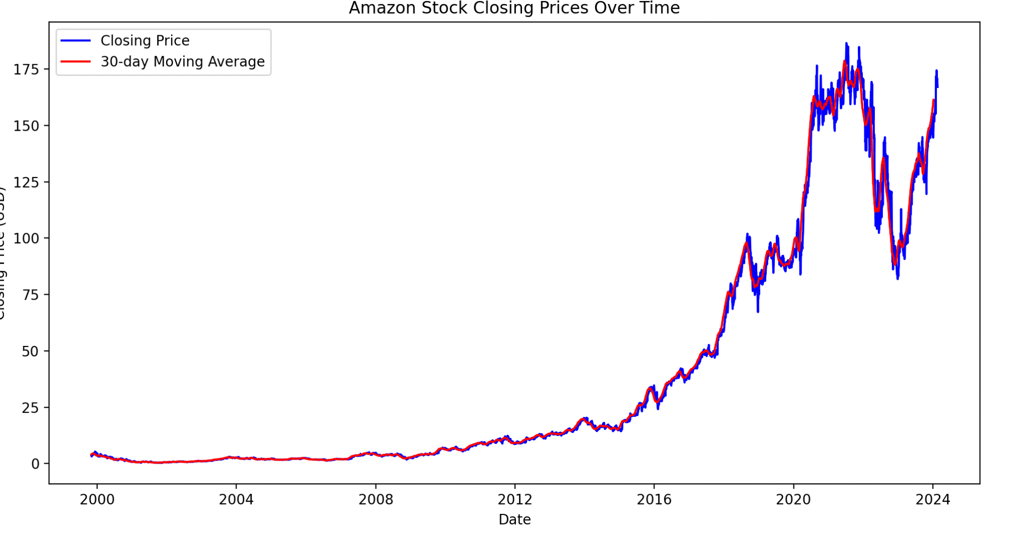
Notes:
The graph shows how Amazon's stock prices changed over time. The dates are on the bottom (x-axis), and the prices are in USD on the side (y-axis). The blue line represents the actual prices, going up and down each day. The red line is the 30-day average, smoothing out the trends to show the overall direction. Spikes in the blue line might mean big changes in the stock price. The red line helps us see the bigger picture, making it easier to spot long-term trends. When the blue line crosses above the red one, it could mean a positive trend (bullish). If it crosses below, it might suggest a negative trend (bearish). This helps us understand how the stock is doing over time.

Slide 18
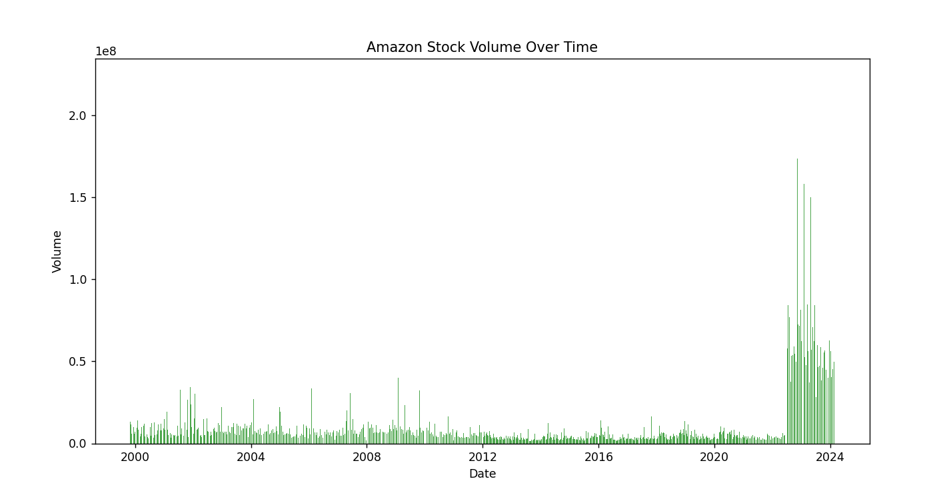
Notes:
The provided plot displays the trading volume of Amazon stock over time. Each bar represents the volume of shares traded on a specific date. The sudden increases in trading volume as you can see from 2020 – 2024 is associated with the stock split. Since the stocks are 20 times cheaper, there’s more volume being moved.

Slide 19
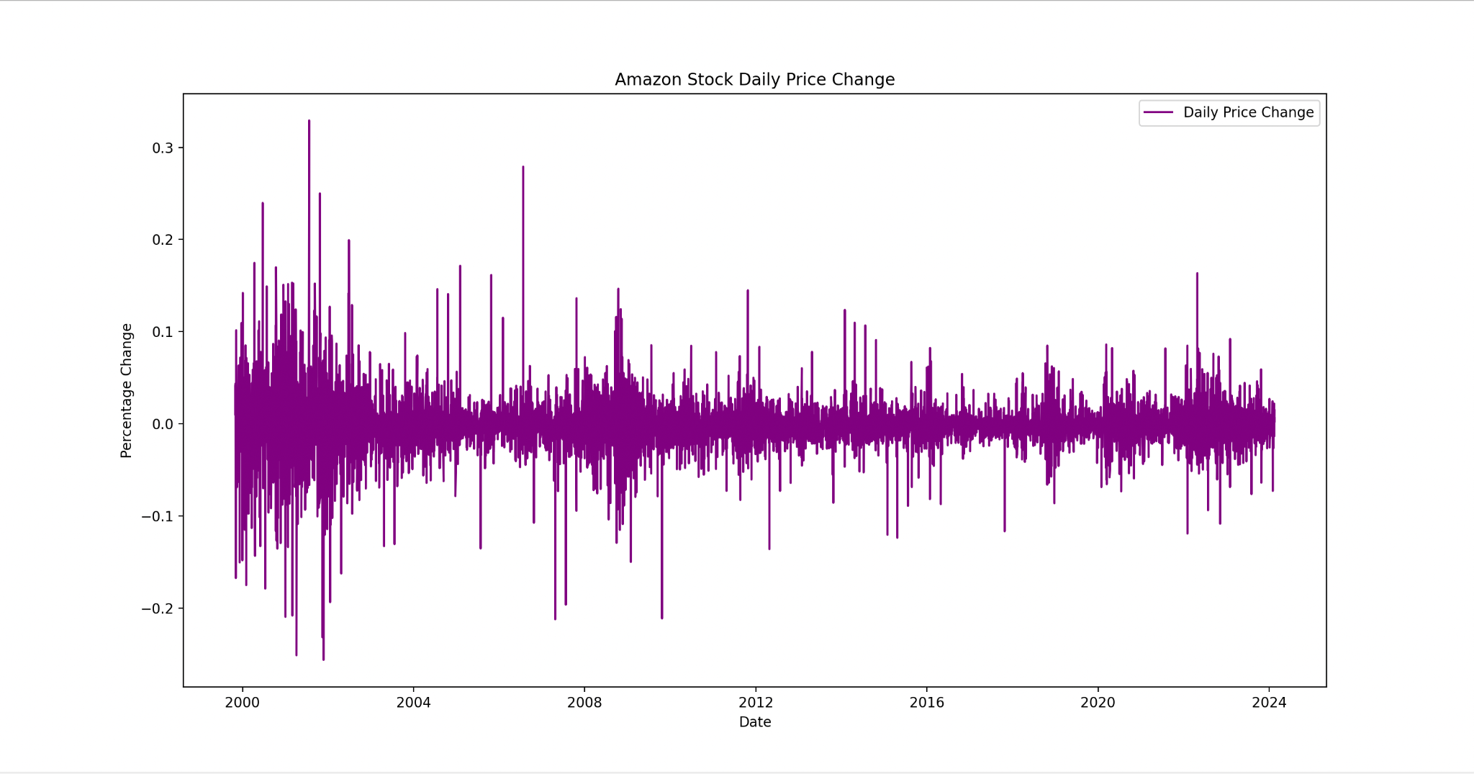
Notes:
The provided plot displays the daily percentage change in Amazon stock closing prices. The line graph represents the percentage change on the y-axis and dates on the x-axis. Positive values on the y-axis represent days with an increase in closing prices, while negative values indicate days with a decrease. Changes in direction can be indicative of shifts in market sentiment or external factors affecting stock prices.

Slide 20
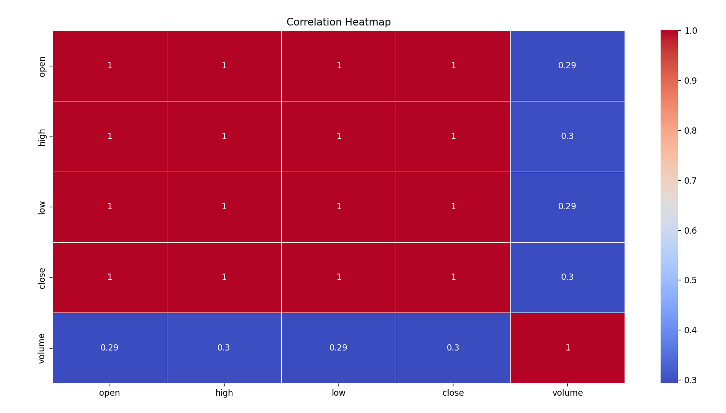
Notes:
The provided plot displays a heatmap representing the correlation matrix of selected features (open, high, low, close, and volume). The x and y-axes represent the features, and the color intensity indicates the strength and direction of the correlation. Positive values (closer to 1) indicate a positive correlation, suggesting that when one feature increases, the other tends to increase as well. Negative values (closer to -1) indicate a negative correlation, suggesting an inverse relationship between features. Values close to 0 suggest a weak or no linear correlation.

Slide 21
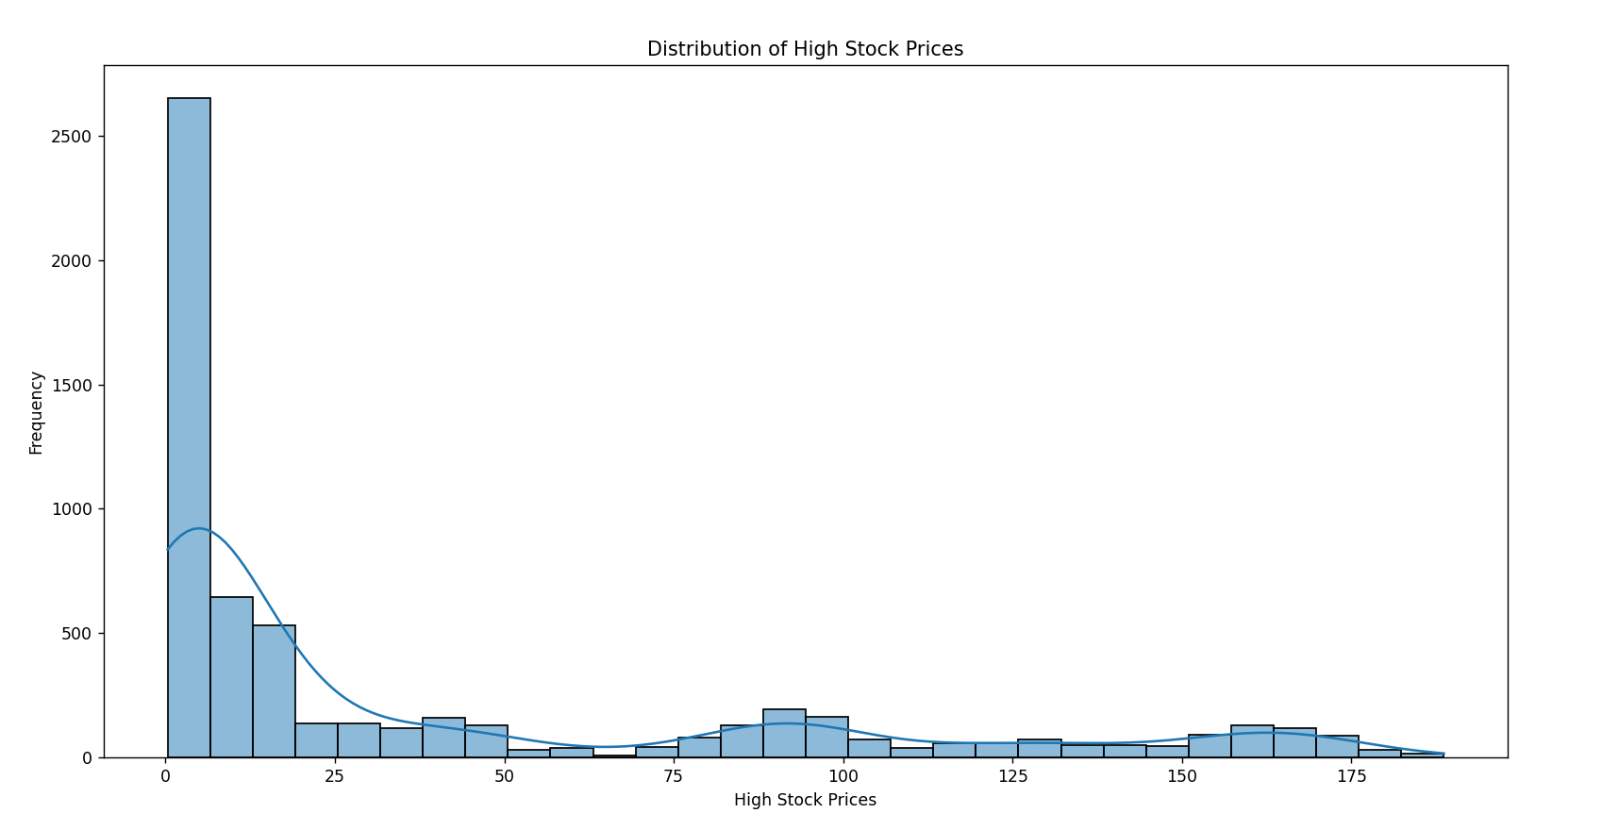
Notes:
The provided plot is a histogram representing the distribution of high stock prices. The x-axis represents the high stock prices, and the y-axis represents the frequency of occurrences. Additionally, a kernel density estimate (KDE) curve is overlaid on the histogram for a smooth representation of the distribution. In conclusion, Amazon spent a long time at a low price and had properly started growing relatively recently.

Slide 22
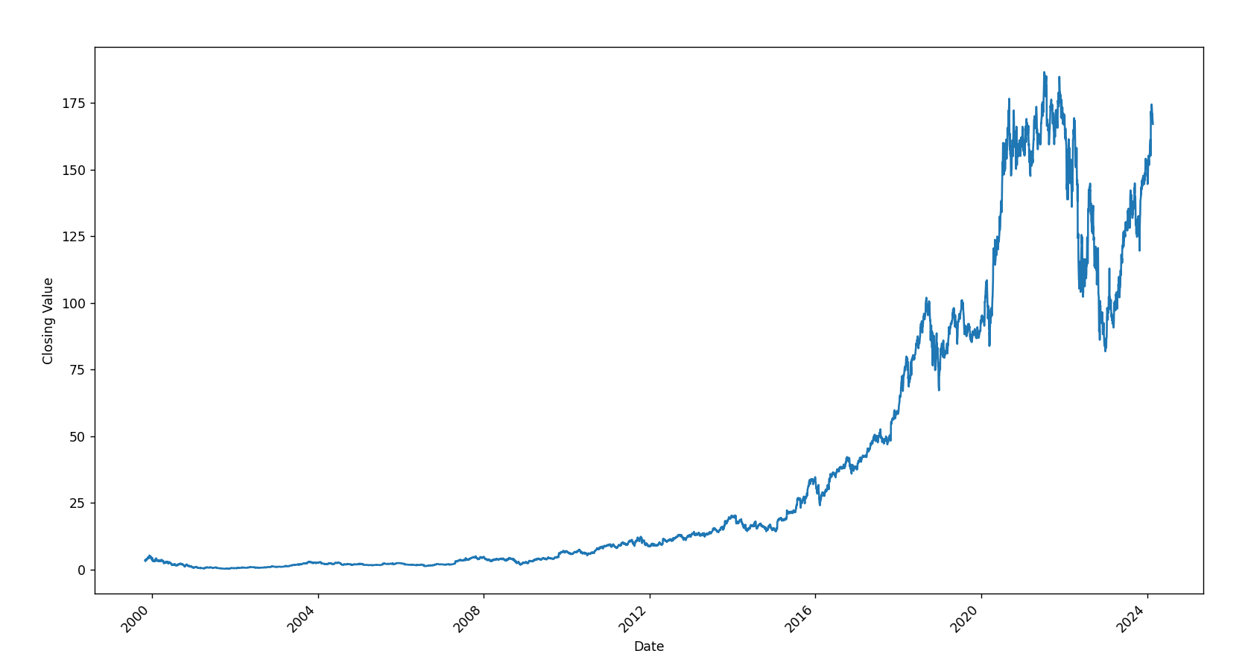
Notes:
The provided plot is a line plot displaying the time series of Amazon's closing values. Each point on the line corresponds to a specific date, providing a continuous representation of the stock's closing price movements. Upward trends may indicate periods of growth, while downward trends may suggest declines.

Slide 23
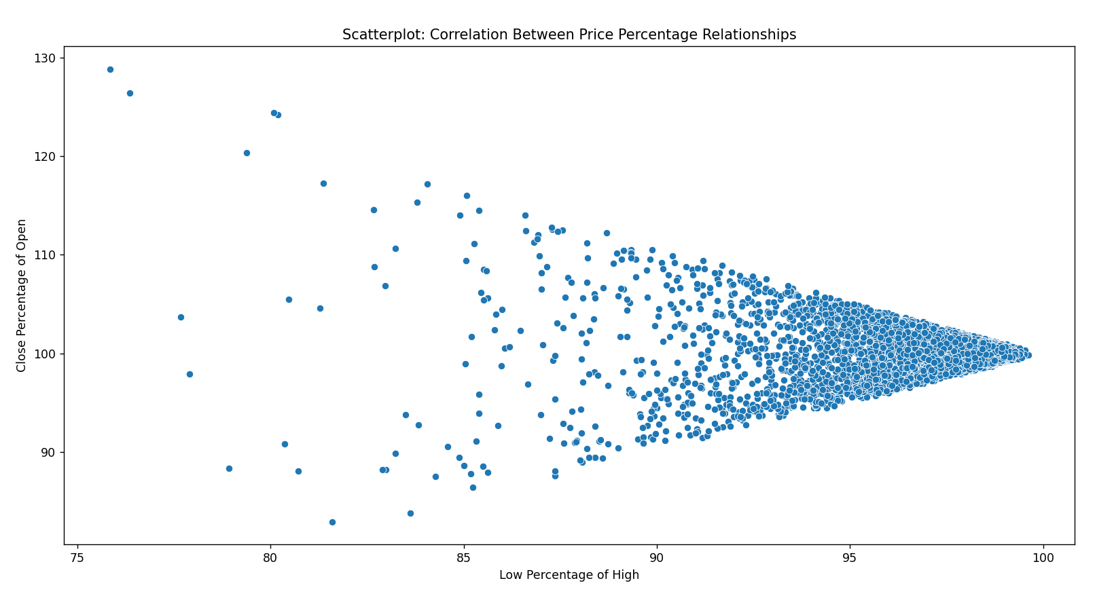
Notes:
The graph shows how the percentage of low prices compared to high prices (Low_Percentage_of_High) relates to the percentage of close prices compared to open prices (Close_Percentage_of_Open). If the points group together or make a straight line, it means they are connected. For example, if one is 100%, the other is also probably close to 100%. This tells us that the percentage of close prices in open prices and the percentage of low prices in high prices are linked. If the percentage of low prices in high prices isn't close to 100%, the percentage of close prices in open prices can vary more. This helps us understand how these percentages are connected and how much they can change.

Slide 24
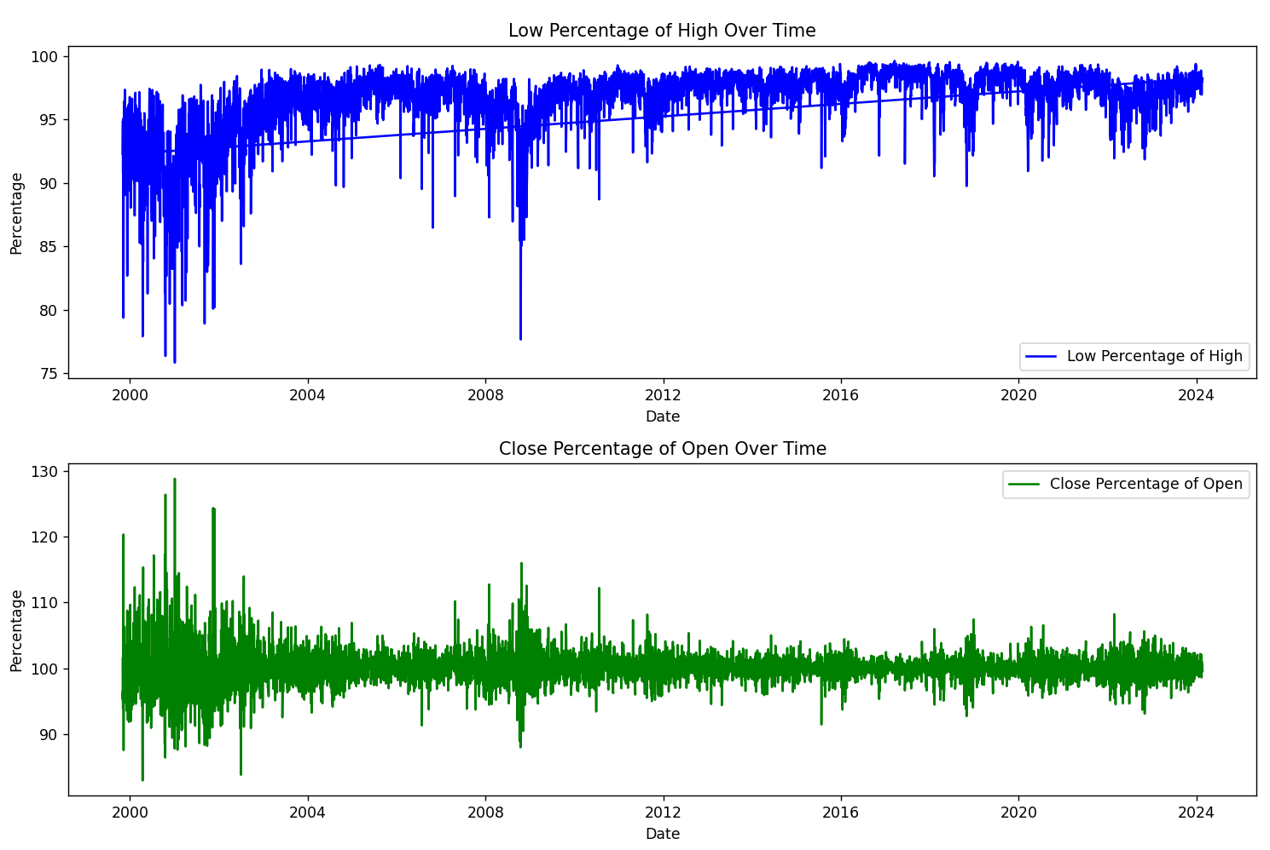
Notes:
The provided plots include two line graphs. The first graph represents the percentage of low prices relative to high prices over time, and the second graph represents the percentage of close prices relative to open prices. Both graphs use time (dates) on the x-axis and percentage values on the y-axis.

Slide 25
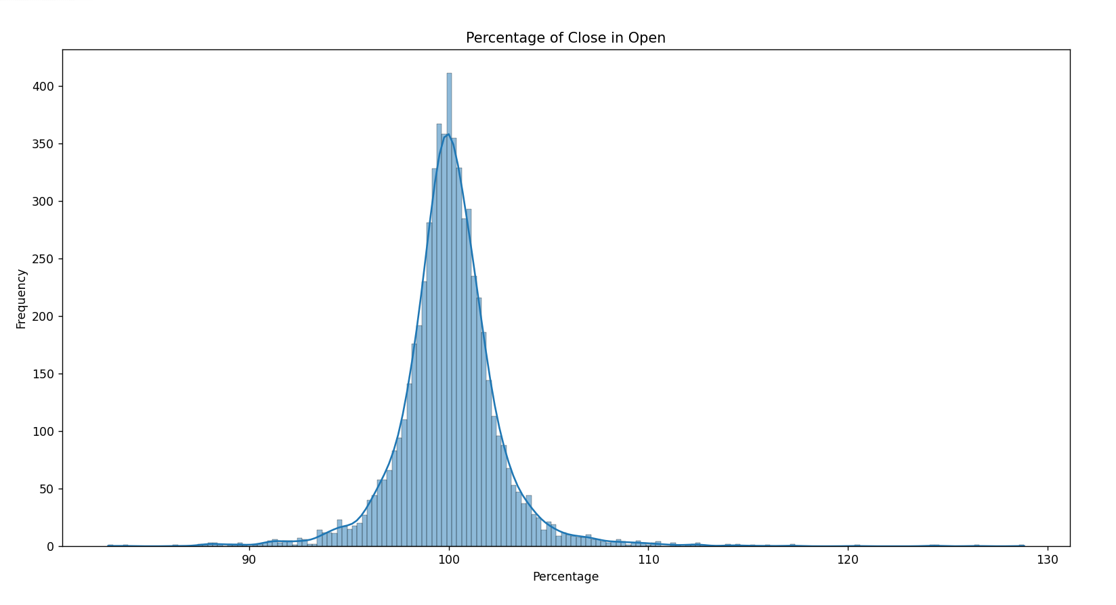
Notes:
In this analysis, our goal is to find out how much the closing prices of Amazon stock differ, on average, from the opening prices. We calculate the average percentage difference by finding the mean of these differences across all dates. To visualize this, we use a histogram that shows the distribution of percentage differences. On the histogram, the x-axis represents the percentage difference, and the y-axis shows how often each difference occurs. Looking at the average percentage difference helps us understand the typical gap between closing and opening prices, giving us an overall measure of how prices change on average.

Slide 26
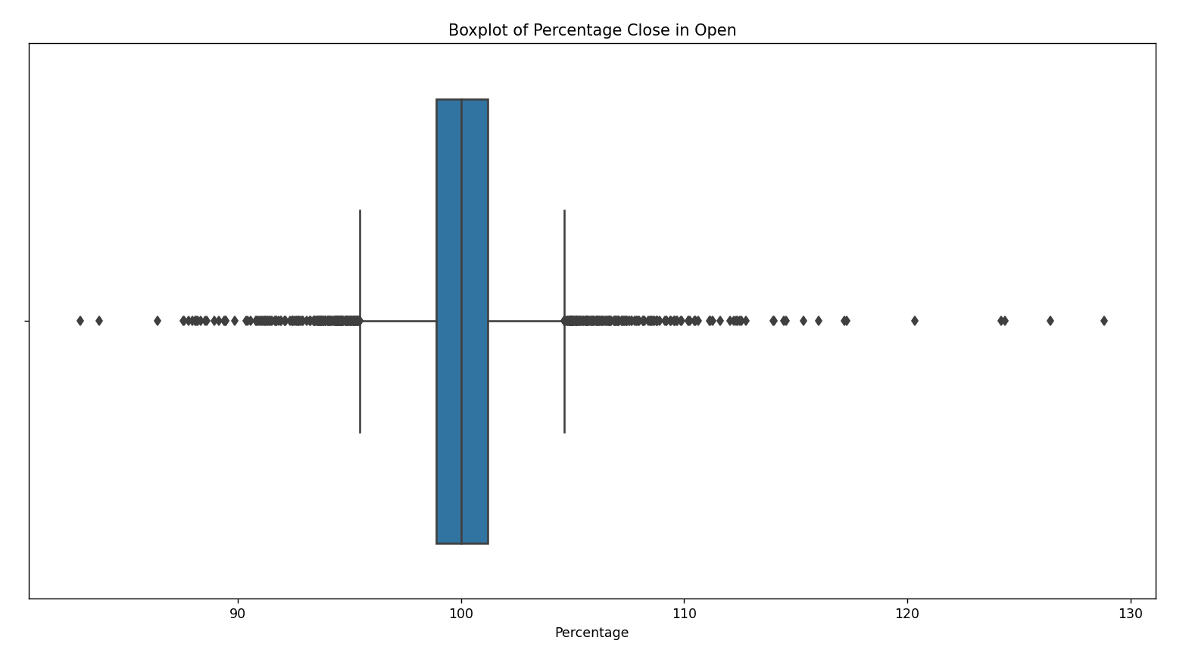
Notes:
In this analysis, we want to find out how much the closing prices of Amazon stock vary from the opening prices, so we're calculating something called the "standard deviation." This helps us see how spread out these differences are across all dates. The standard deviation tells us how much each day's difference is different from the average difference. To show this visually, we use a boxplot. The box in the middle represents where most of the differences lie, and the whiskers show the range of differences within a certain limit. Any points beyond the whiskers are considered unusual. A higher standard deviation means the differences vary a lot, while a lower one means they're more consistent. This helps us understand how much the prices change from day to day.

Slide 27
06
Lessons learned

Slide 28
Lesson #1
The Problem
The Lesson
Had to make the code infinitely reusable without flooding the database with duplicates or getting the 'unique key' error
Took current state of table into account, implemented checks to determine parameter of API call
Filtered dataframe to only latest date(s) not already present in table
Take a goal-oriented approach to solve problems, don't be afraid to come at it from different angles
Thoroughly account for as many possible use-case scenarios as possible

Slide 29
Lesson #2
The Problem
The Lesson
Raw stock price data saw an enormous drop-off after 6/5/22
AMZN had underwent a stock split (by a factor of 20) at that time, dramatically skewing the data from that point onwards; full graphs from 1999-present showed a massive, misleading drop in price
We divided all data from before 6/5/22 by 20 prior to visualization and analysis
Always look into significant discrepancies or outliers in raw data and account for them, otherwise the analysis could be rendered worthless
Many times, external research should be conducted

Slide 30
Lesson #3
The Problem
The Lesson
The nature of this project structure lent itself to team members finishing certain checkpoints very quickly. Leaving some team members done with their jobs in order for others to begin..
Most people don’t want to go and ask team members for help, and feel like their burdening others. Let them know you are bored! And want to help!

Slide 31
Lesson #4
The Problem
The Lesson
Initial challenge was deciding which aspects of the data to graph.
Once the visuals were created, extracting meaningful insights demanded a thorough understanding of the dataset
Selecting the right visuals was crucial.
Deeper understanding of the dataset for better analysis
Experimenting with different graphs and refining them based on insights for overall quality of the visuals

Slide 32

END

